Slide 1
NABBOUL The Magic Robot
Charbel El Beaini 202001541
Christy El Skaff 202001280
Joanne Rizkallah 202000840
Nadine Sfeir 202000986

Slide 2
About the Project
01.
Major Requirements
02.
04.
Procedure
Project Goals
03.
05.
Conclusion
Introducing NABBOUL
Specifications and Hardware
What we learned
What NABBOUL can do

Slide 3
NABBOUL
NABBOUL is an interactive robot that talks, listens and most importantly, performs many magic tricks that is guaranteed to amaze all those who watch him.

Slide 4
Tricks
Trick 3
Trick 2
Card guessing trick
Trick 1
Pen and its cap trick
Card changing trick

Slide 5
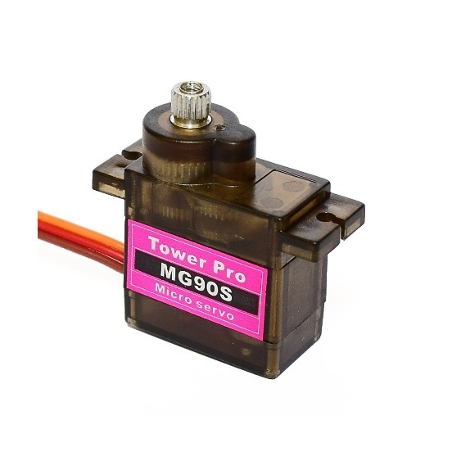
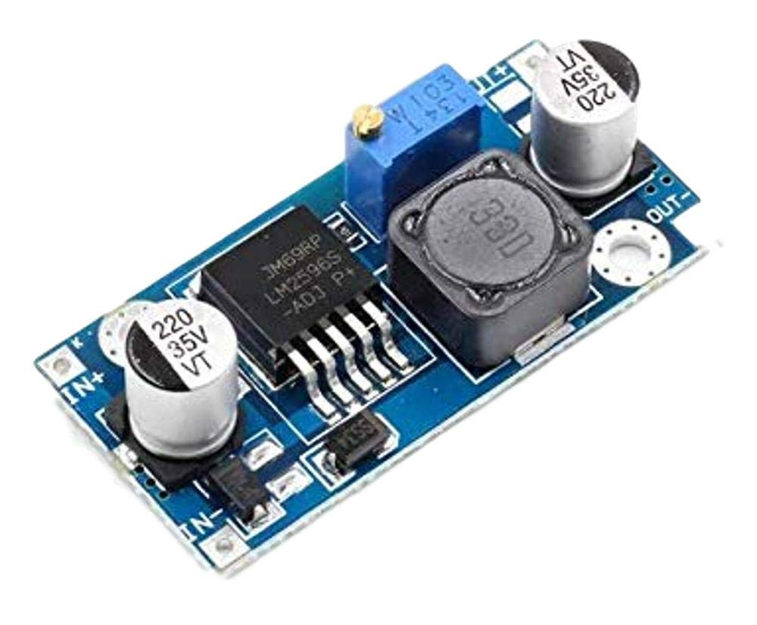
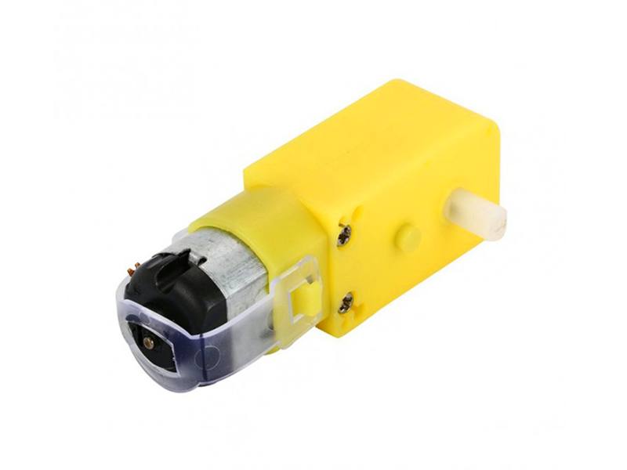
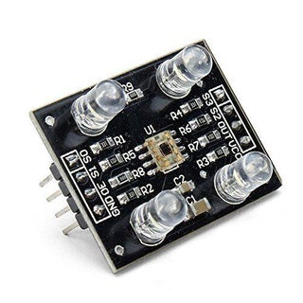
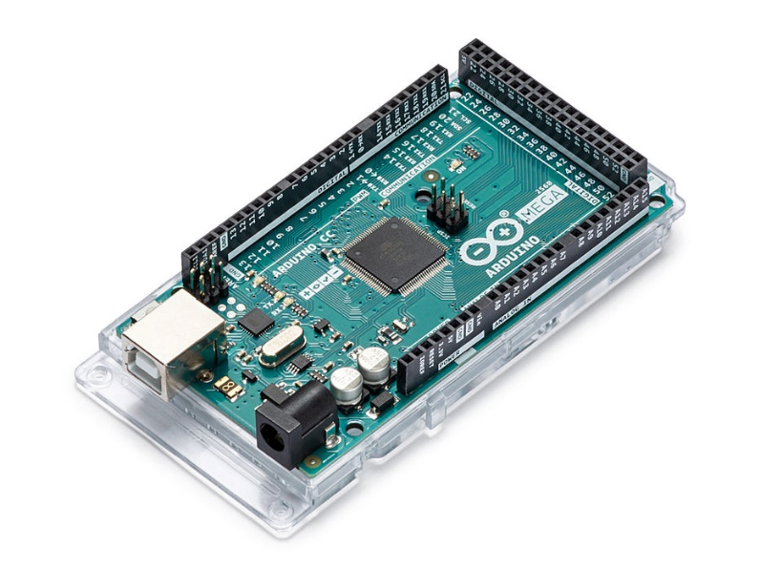
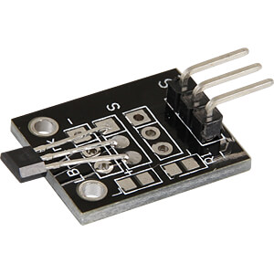
Hardware
Micro servo motor MG90S
Servo motor DC Buck Converter
DC motor
Color sensor
Bihor magnetic sensor AH49E
Arduino Mega

Slide 6
Project Goals
Magic
Speech
Expressions
NABBOUL can perform 3 different magic tricks
NABBOUL can hear what is said to him and talk back
NABBOUL can change his facial expression

Slide 7
What We Learned
1
Hardware Implementation
3
Arduino Code
Speech Recognition
2
4

Slide 8
Thanks!

